Slide 1
Business context analysis
Grocery store – website for selling goods

Slide 2
I. BUSINESS CONTEXT
Grocery App covers the entire grocery shopping journey – from product discovery, cart management, order placement and tracking, to the seller’s dashboard – through well-defined frontend/backend routes.
This app have features for both clients (user) and Administrator that can work well in mostly every shopping situation.
For example:

Slide 3
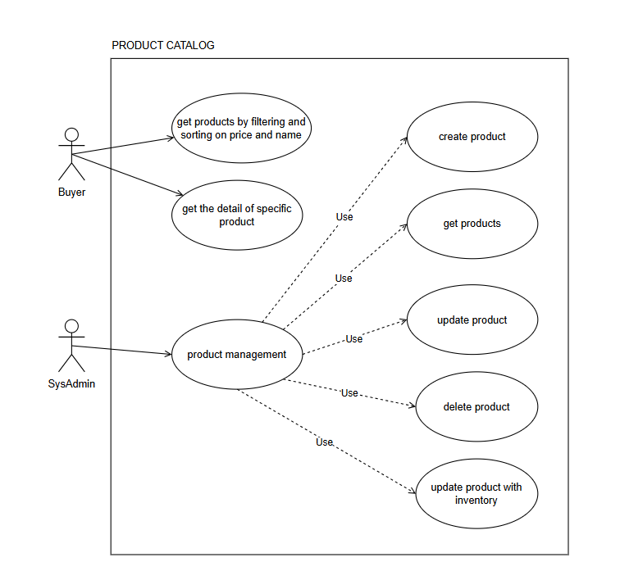
Product catalog

Slide 4
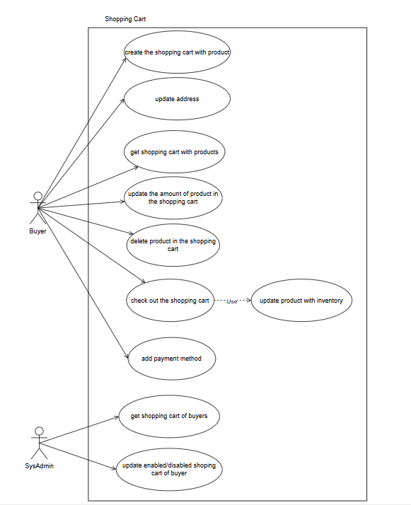
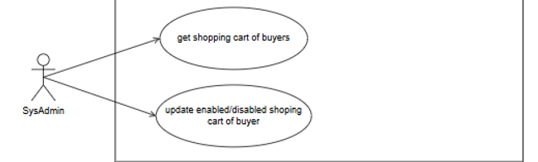
Shopping cart
These are some main features for shopping process
For Buyer, they can add their choice in to cart and continue shopping. Delete and add products or change the quantity are what they can do
For Seller, they can access to manage all users orders

Slide 5
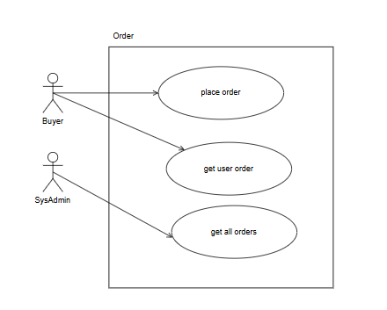
Order management
After the shopping, they will move to the order process. Right before click the order button, they will need to fill the address and choose paying method
Seller can manage the user’s orders by get all orders

Slide 6
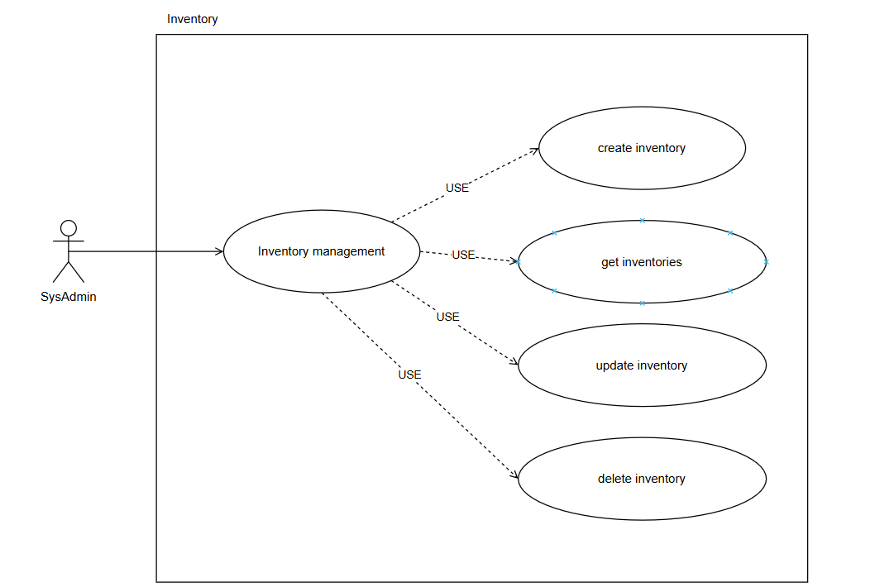
Inventory management
Administrator can manage the product and inventory
Some main functions: create products, get products details and disable product

Slide 7
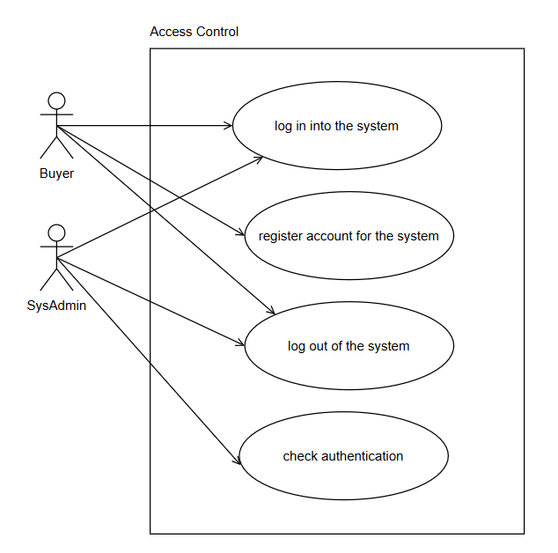
Access control
For access control both user and admin can all do the log-in and log-out process
But for user they can register new account for the first time they visit the web
Authentication is the process for check the account is available or not.

Slide 8
Thank you for your attention
Members:
  Trần Hảo Điền
  Ngô Tuấn Anh
  Nguyễn Phương Vinh
  Lê Ngọc Hiệp

